Slide 1


Types and Classification of Attacks/Threats
Slides are prepared from the book Cryptography and Network Security by William Stallings

Slide 2
Welcome!!
Insert the title of your subtitle Here

Slide 3
Learning Outcomes
Understanding of:
Different types of attacks
Classification of attacks
Passive vs Active attack

Slide 4
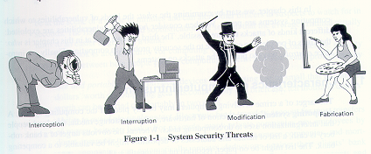
Type of Attacks/Threats in Computer Systems
A threat is a danger which could affect the security (confidentiality, integrity, availability) of assets, leading to a potential loss or damage.
Interruption
Interception
Modification
Fabrication

Slide 5
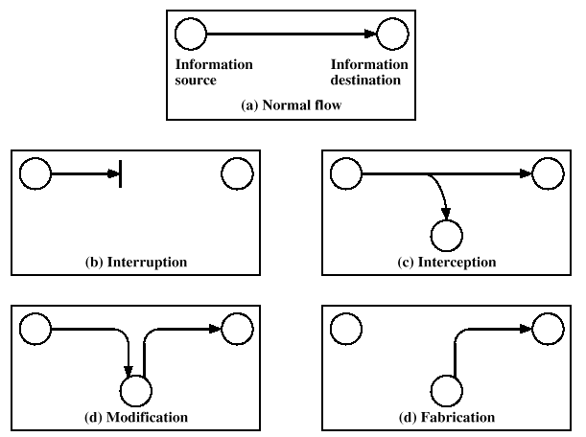
Type of Attacks in Computer Systems

Slide 6
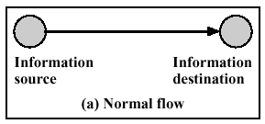
Normal Flow of Information

Slide 7
Interruption
An asset of the system is destroyed or becomes unavailable or unusable. This is an attack on the availability.
Examples include destruction of a piece of hardware, such as a hard disk, the cutting of a communication link, or the disabling of the file management system.
DOS - Denial of Service Attacks have become very well known. [DDOS]

Slide 8
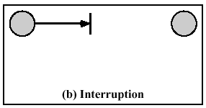
Interruption

Slide 9
Interception
Information disclosure/information leakage
An unauthorized party gains access to an asset.
This is an attack on confidentiality.
The unauthorized party could be a person, a program, or a computer.
Examples include:
  wiretapping to capture data in a network
  the illicit copying of files or programs

Slide 10
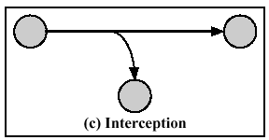
Interception

Slide 11
Modification
Modification is integrity violation.
An unauthorized party not only gains access to but tampers with an asset.
This is an attack on the integrity.
Examples include changing values in a data file, altering a program so that it performs differently, and modifying the content of a message being transmitted in a network.

Slide 12
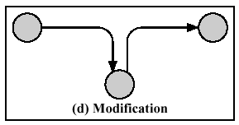
Modification

Slide 13
Fabrication
An unauthorized party inserts counterfeit objects into the system. This is an attack on the authenticity, (as well as integrity).
Inserting messages into the network using the identity of another individual
Spoofing a web site or other network service

Slide 14
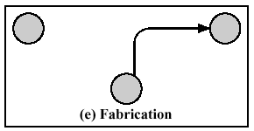
Fabrication

Slide 15
Classification of Attacks
Computer Security attacks can be classified into two broad categories:
  Passive Attacks can only observe communications or data.
  Active Attacks can actively modify communications or data. Often difficult to perform, but very powerful. Examples include
    Mail forgery/modification
    TCP/IP /session hijacking

Slide 16
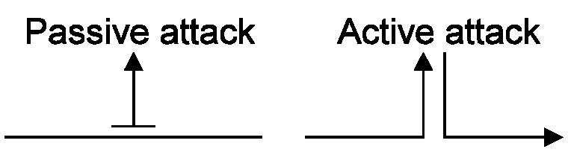
Passive Attacks and Active Attacks

Slide 17
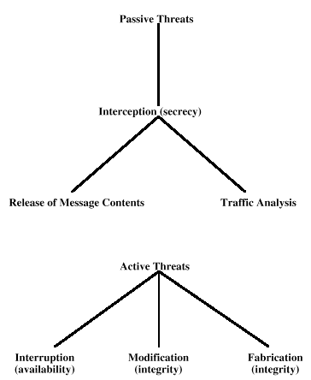
Passive Attacks and Active Attacks

Slide 18
Passive Attacks
Eavesdropping on or monitoring of transmission.
The goal of the opponent is to obtain information that is being transmitted.
Two types:
  Release-of-message contents
  Traffic Analysis

Slide 19
Release-of-message Contents
Opponent finds out the contents or the actual messages being transmitted.
How to protect?
  Encryption

Slide 20
Traffic Analysis
More subtle than release-of-message contents.
Messages may be kept secret by masking or encryption but …
The opponent figures out information being carried by the messages based on the frequency and timings of the message.
How to protect?
  Data/Message Padding
  Filler Sequences

Slide 21
Passive Attacks Problems
Difficult to detect because there is no modification of data.
Protection approach should be based on prevention rather than detection.

Slide 22
Active Attacks
Active attacks involve some sort of modification of the data stream or the creation of a false stream.
Four sub-categories:
  Masquerade
  Replay
  Modification of Messages
  Denial of service

Slide 23
Masquerade
An entity pretends to be another.
For the purpose of doing some other form of attack.
How to protect?
  Principal/Entity Authentication

Slide 24
Replay
First passive capture of data and then its retransmission to produce an unauthorized effect.
Could be disastrous in case of critical messages such as authentication sequences, even if the password were encrypted.
How to protect?
  Time stamps
  Sequence Numbers

Slide 25
Modification of Messages
Some portion of a legitimate message is altered or messages are delayed or reordered to produce an unauthorized effect.
How to protect?
  Message Authentication Codes
  Chaining (purified)

Slide 26
Review Questions
What is the difference between Interruption and Interception
What is Masquerade and Replay
How Fabrication is different from Modification

Slide 27
Thank you
Insert the title of your subtitle Here

